Slide 1
Return to Work in Germany:
Evidence and Challenges
Marco Streibelt,
German Federal Pension Insurance
Department for Rehabilitation Research
Notes:
Was sehen wir?
Was heißt das?

Slide 2
At first:
Some “basics” regarding the rehab system on behalf of the GPI

Slide 3

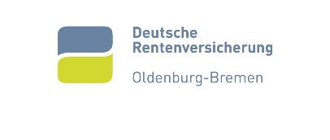

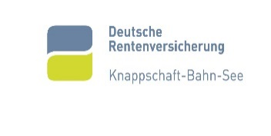
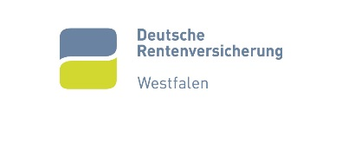





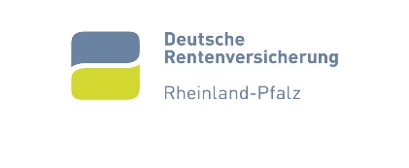




The German Pension Insurance

Slide 4
Medical Rehabilitation (MR)
long history (~120 years)
„standard“ treatment in Germany
  full-time multimodal intervention,
  duration: 3 to 4 wks,
  ~60 to 80 hours
Different disease groups (“indications”), most famous:
  Musculoskeletal
  Mental
  Cancer
  Cardiovascular
  Others (neurological…)

Slide 5
Vocational Rehabilitation: Types of Benefits
“Benefits for participation in working life”: various types of assistance that help people find their way back into working life
Types of benefits:
  Assistance to maintain or obtain a job
  Vocational preparation including basic training
  Vocational training: Training, vocational adjustment, specific qualification and further training such as retraining
  Specials…
  “Start-up funding” for self-employment
  “Integration funding” to employers and companies
  counselling and assessment to support people in making adequate decisions about their rehab path and future job
Notes:
Priority is given to maintaining an existing job

Slide 6
The German rehab system: is it effective?
1990: „rehab commission critique“
  aim: RTW ???
  no evidence regarding absolute effects
  (MR vs. no MR)
Up to now: Evidence
  Rehab is effective in some disease groups: Asthma bronchiale, inflammatory diseases
  In main disease groups (musculoskeletal, mental: only low evidence)
  Observational studies show large to middle short term effects, but only low long term effects
Recommendations: We need…
  more work orientation
  a better support of RTW after rehab
  a coordination especially for complex cases

Slide 7
Challenge 1:
The Work orientation in Medical Rehabilitation

Slide 8
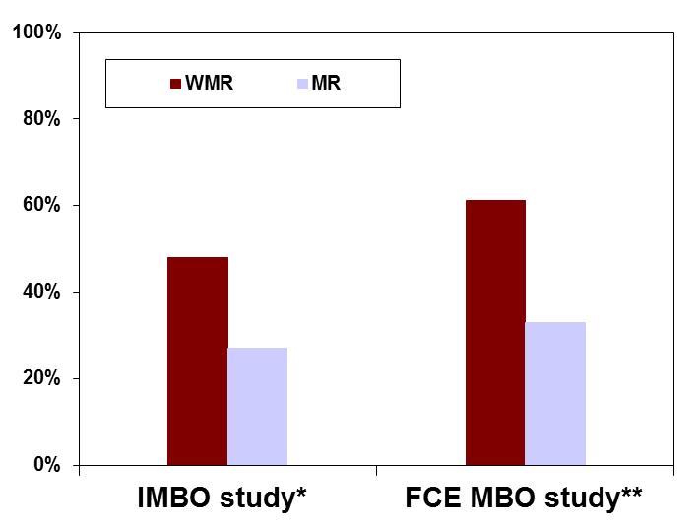
Evidence of WMR
Outcome:
„stable RTW“
(working without sick leave
after rehab)
Increased Outcome of about 20%-points
  MR: 40%, WMR: 60%
  Number needed to treat: 5
Only observed for WMR target group
Musculoskeletal disorders
* Bethge et al. 2011, ** Streibelt and Bethge 2014a

Slide 9
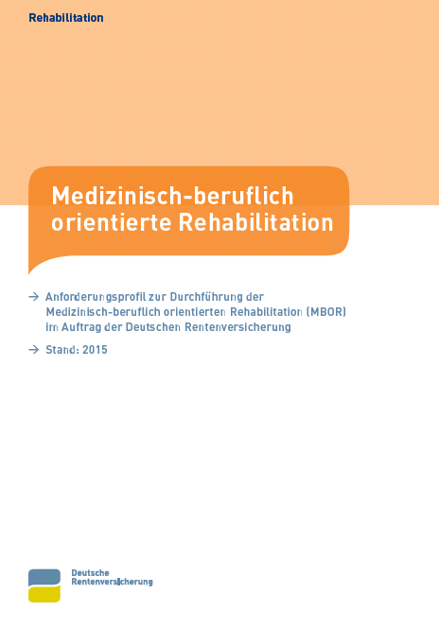
WMR – elements and target group
Intensified MR focussed on the individual work conditions
Basic principle: work performance
Core elements:
  Work-related diagnostics (incl. FCE)
  Work-related psychosocial counselling
  Work-related education groups
  Functional capacity training
Target group: „high risk of non RTW“
  Long term sick leave, unemployment, negative subjective RTW prognosis
  Changing the work (need for further voc rehab)
WMR guideline
Recommendation:
11 to 27 hours per rehab
Streibelt and Buschmann-Steinhage 2011, GPI 2015

Slide 10
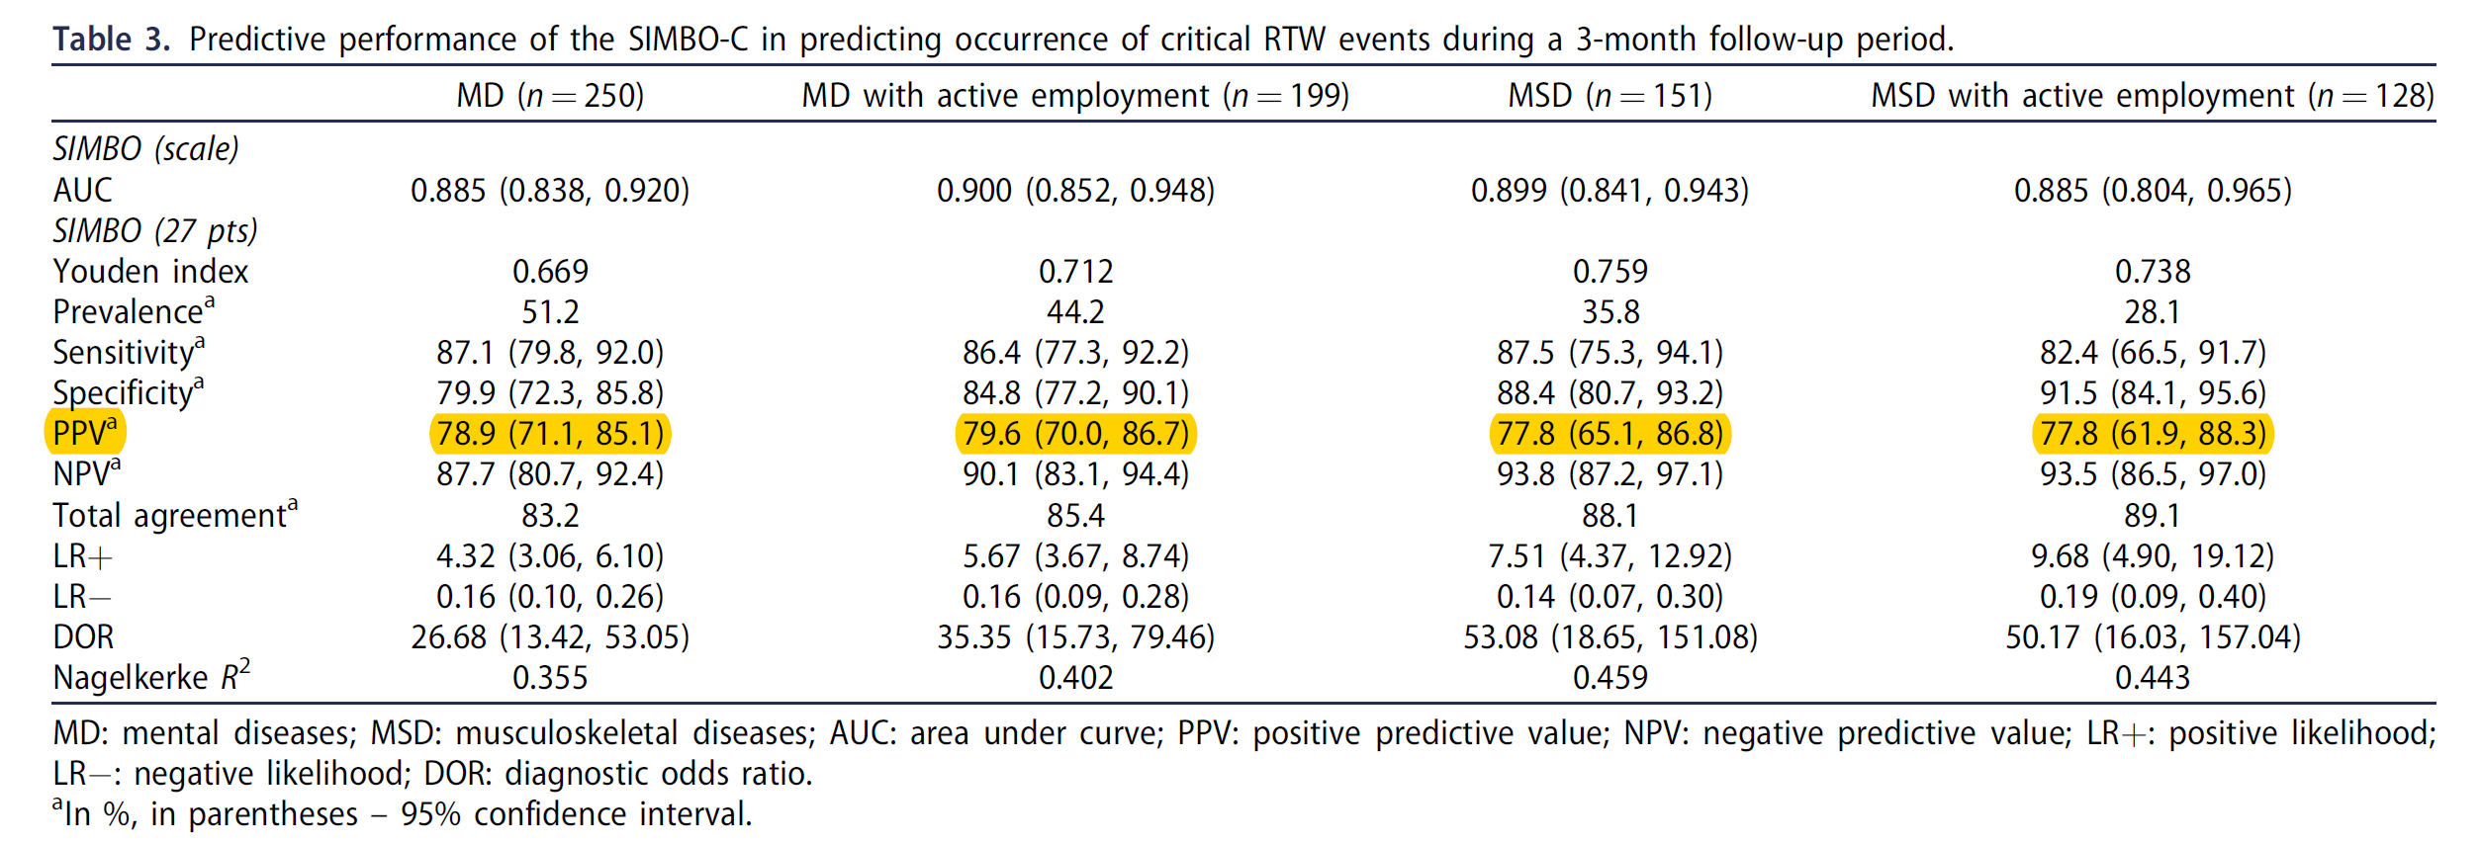
WMR – identifying the target group
+
Work-related model
approval for rehab
decision
-
medical rehab
Streibelt M, Bethge M. Disabil Rehabil. 2018 Mar 23:1-7

Slide 11
Challenge 2:
How to support people after rehabilitation?

Slide 12
Background
Graded Return to Work (GRTW)
  since 2004 German Pension Insurance (GPI): also responsible for the post-rehabilitation process
  support of RTW after multimodal rehabilitation (MR)
Effectiveness
  positive effect on full RTW for somatic disorders couldn´t be confirmed for mental disorders (Hogelund et al 2012)
  small effect on full recovery, but the effect was higher with a longer period of full sick leave (Andrén 2014)
  contrary: negative effect of increasing the work demands (exposure-based RTW) in a RCT in the Netherlands (Noordik et al. 2013)

Slide 13
Effects on RTW (12 months)
RR = 1.22 (1.13 – 1.31)
RR = .41 (.26 – .65)
RR = .40 (.23 – .70)
%
Key Message
Significant benefit of GRTW regarding primary outcome (full RTW, unemployment and claim for disability pension)

Slide 14
Challenge 3:
The coordination of Return to Work

Slide 15
Background
Return to Work (RTW) is – in a manner of cases – not easy and conditional
  Barriers also outside of the health problem (work, private, …)
  Different stakeholders are involved
  Dependent on the existing rehab system
Effective RTW interventions very often including a coordination / case management
But:
  How should a coordination be designed?
  Who should do this?
We know, that such a coordination is effective, but don´t know why!
Aim: Identification of „evidence“ from qualitative studies
  What are barriers, what are supporting factors for RTW?

Slide 16
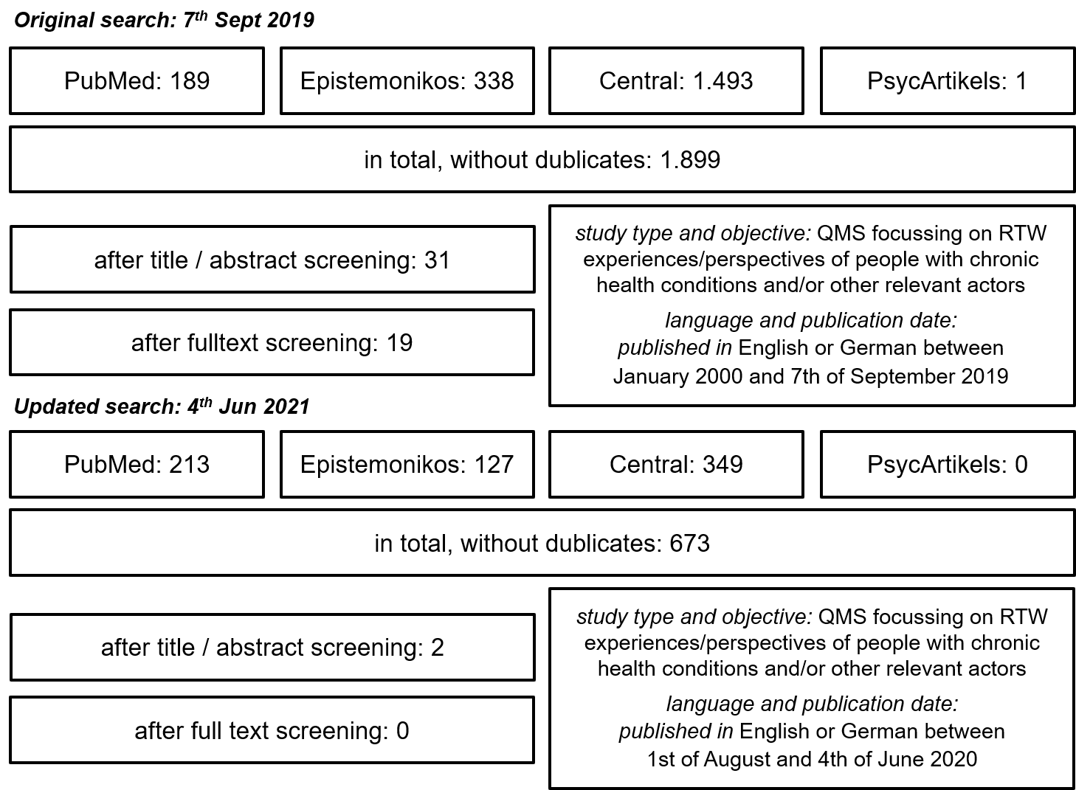
Systematic review of systematic reviews of qualitative research

Slide 17
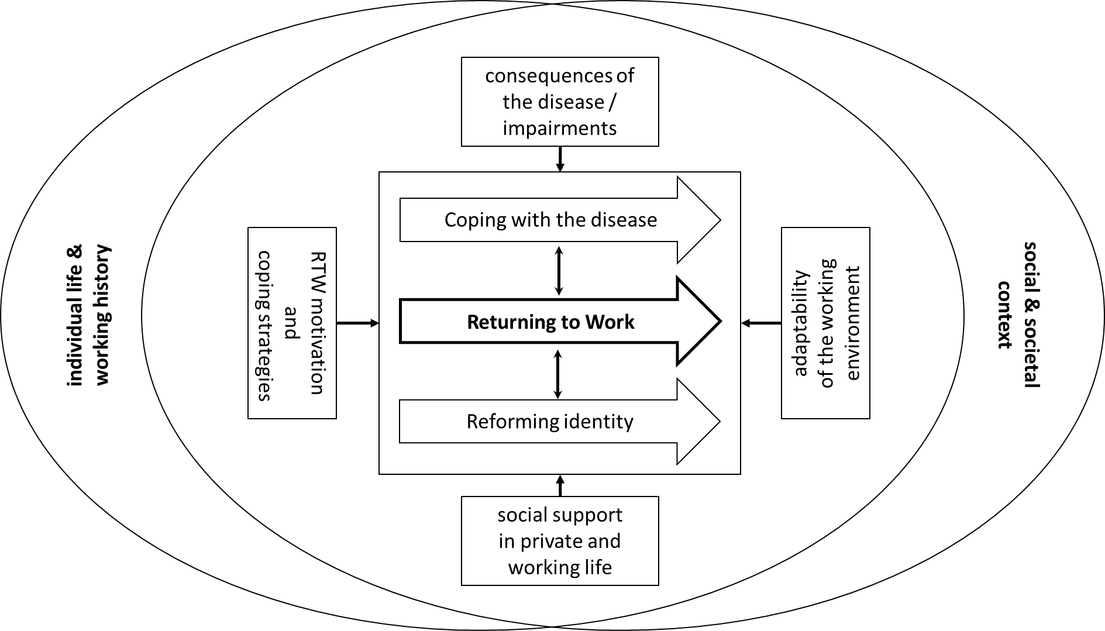
Definition of RTW

Slide 18
Definition of RTW
RTW
Is a multi-factorial and highly interactive multi-stakeholder process,
embedded in an individual life and working history
as well as in a certain social and societal context,
affecting the further coping of the illness and the identity of the person
and is not only shaped by the direct consequences of the disease and the RTW motivation and coping strategies of the person,
but also and particularly by the social support in private and working life and the adaptability of the person’s working environment
RTW is therefore not only a matter or problem of an individual, but rather of a social system, requiring a holistic, person-centred and systemic approach, and
a designated coordinator.

Slide 19
Let´s come to an end!

Slide 20
What we concluded in Germany…
Not all persons need the same intensity of rehab
  Is the right target group addressed in my intervention?
  Do I have valid criteria to identify the need?
For a successful RTW of persons with chronic diseases
  you need a continuous orientation on the working conditions
  all relevant parties must be involved at an early point of time
  you need an agreement on the main goal „RTW“ from all parties
  a „coordination of interests“ is necessary
RTW is (very often) not a question of therapy, but of „individual and organisational change management“ !

Slide 21

Rehabilitation in Germany
Dr. Marco Streibelt
German Federal Pension Insurance
Rehabilitation Research
Tel +49 (0) 30/ 865 - 39330
Mail marco.streibelt@drv-bund.de

